Slide 1
Voltage Regulators & LDO
Nagy richárd, mechatronics, 25223020

Slide 2
Voltage Regulators
Zenner diode based voltage regulator;
Linear voltage Regulator;
Switching Converters – Buck, Boost, Buck-Boost Converter;
Flyback Converter;
AC-DC voltage conversion;
DC-AC conversion;

Slide 3
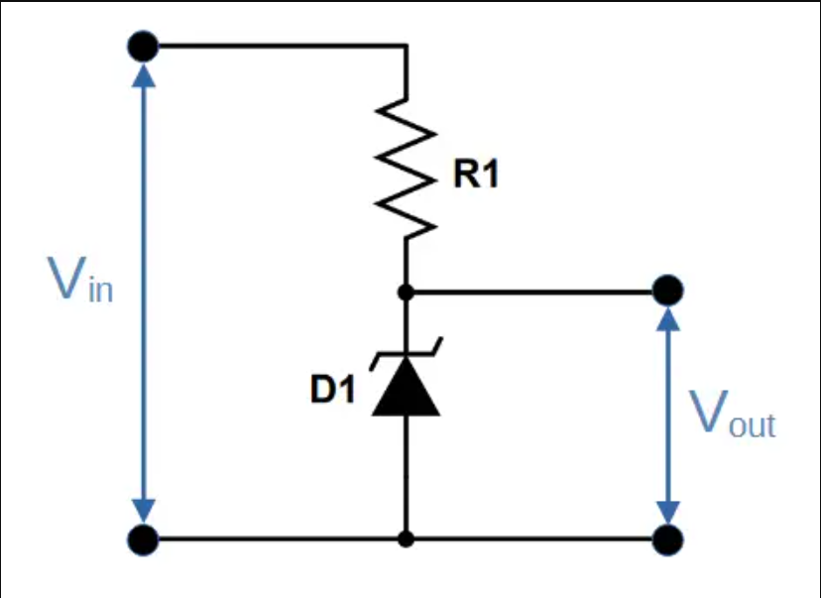
Zener diode based voltage regulator
Advantage;
Disadvantage;
Working principals

Slide 4
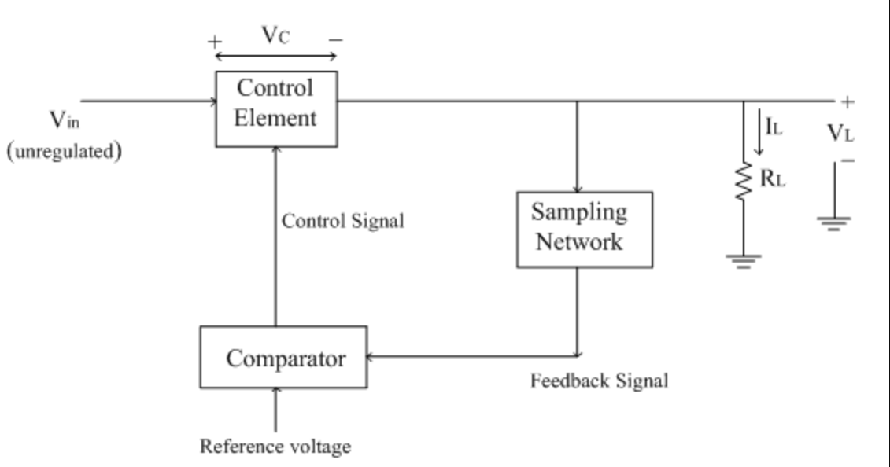
LDO – Low Voltage Dropout regulator
Advantage;
Disadvantage;
Working principals;

Slide 5
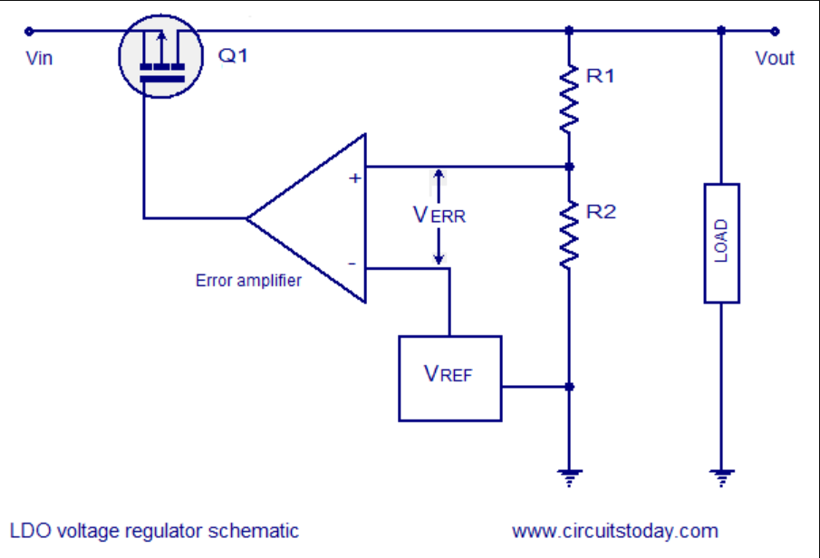
LDO internal structre
Op amp;
Resistor divider;
VREF voltage;

Slide 6
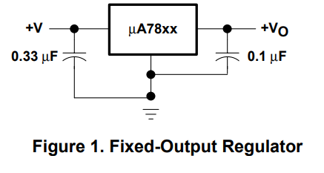
LDO – 7805 – Single Rail Power Supply
Capacitor Size;
Capacitor Placment;

Slide 7
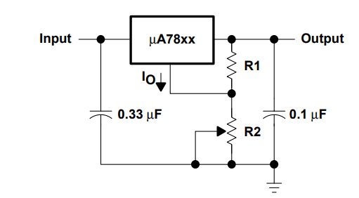
LDO – 7805 – Adjustable Output Regulator
How to size resistors?
Vout = Vin * (R2 / R1 + R2)

Slide 8
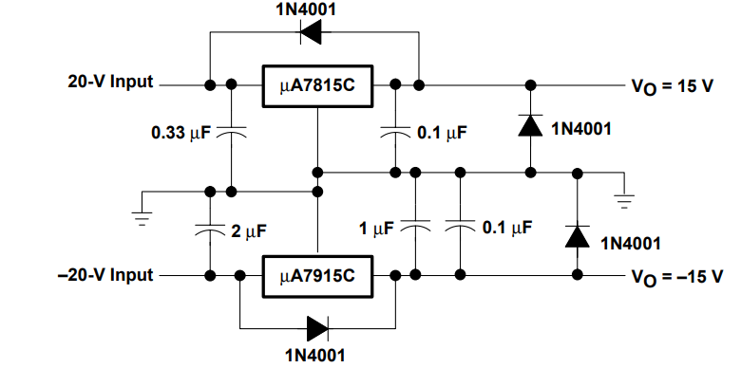
LDO – 7805 – Dual Rail Power Supply
Where useful?

Slide 9
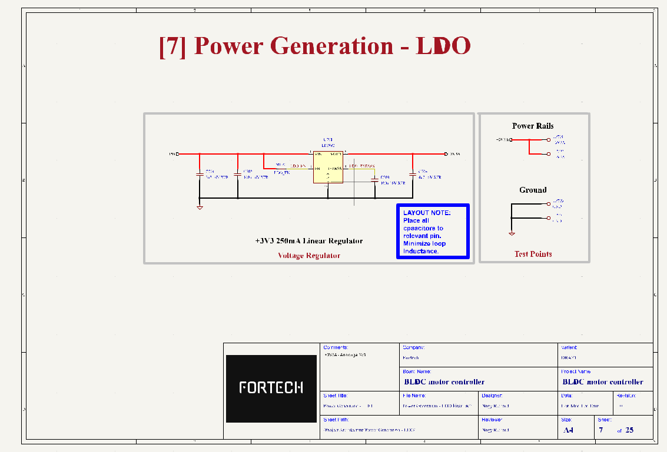
LDO – Example Usage

Slide 10


